Slide 1

SWAN
LED light abnormal
Prepared by: PE- Long
Date : 2023.08.15
"Listens to customers, Meet customer expectation"

Slide 2
Information
SWAN build 3000pcs, FATP test 100pcs find out 100pcs all led light abnormal.
- Defect rate: 100%
- Fail symptom: All LED light abnormally.
Detail information as below:
Model Name | K18X001.00 | Vendor Name | EVERLIGHT | DC | 230723
Rate | 100% | Customer | ALT | Sample for FA | 3pcs
P/N | 123.00701.005 | Failure main | PCBa 96.1515T00, 96.1520T00, 96.1540T00 used total 30 location
Failure symptom | All LED light abnormally
"Listens to customers, Meet customer expectation"

Slide 3
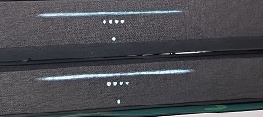
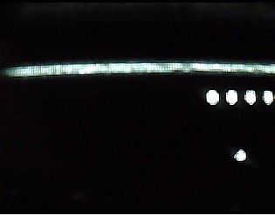

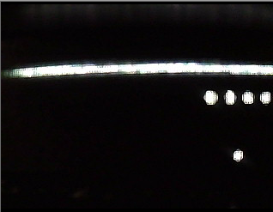
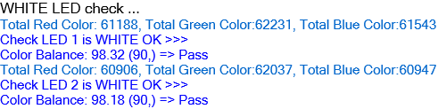
Background Information
On 2023/08/14 to 2023/07/15, K18X001.00 test 100pcs find out 100pcs led status light abnormal
Defect rate: 100%
NG
OK
Summary:
- With OK sample ➔ LED white light normal.
- With NG sample ➔ LED light have white color is lower
"Listens to customers, Meet customer expectation"

Slide 4
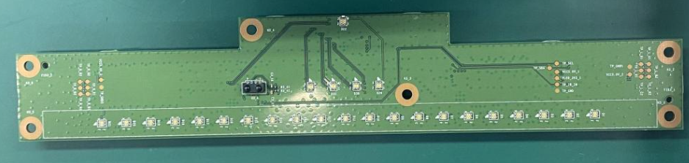
Board level-1: Visual Inspection
Visual inspection:
- Check VI housing P/N: 441.0094.015 and LED P/N: 123.00701.005 on PCB: 96.1515T00, 96.1520T00, 96.1540T00
PCB: 96.1515T00
Summary: Check VI ➔ Don’t find out abnormally related to housing and process issue
"Listens to customers, Meet customer expectation"

Slide 5


Board level-2: Remove housing
Remove housing and re-check LED:
NG
(New DC)
OK
(Old DC)
Summary:
New DC:230723 have white coler is different a little with old DC.
"Listens to customers, Meet customer expectation"

Slide 6
Board level-3: Measure Voltage
Measure power voltage on LED ,received result as table below:
Measure Voltage Power (V)
No. | Description | OK | NG1 | NG2 | NG3
Pin 1 | LED_R | 3.229 | 3.20 | 3.24 | 3.21
Pin 2 | LED_G | 2.242 | 2.19 | 2.23 | 2.22
Pin 3 | LED_B | 2.22 | 2.11 | 2.18 | 2.19
Pin 4 | PP_PWR_IN | 5.01 | 5.06 | 5.10 | 5.09
Summary: Measure power voltage on LED ➔ No found out abnormal.
"Listens to customers, Meet customer expectation"

Slide 7
Board level-4: Measure Impedance
Measure impedance on LED and received result as table below:
Measure Impedance
No. | Description | OK | NG1 | NG2 | NG3
Pin 1 | LED_R | 11.44M | 11.55M | 11.52M | 11.45M
Pin 2 | LED_G | 10.71M | 11.62M | 11.70M | 11.75M
Pin 3 | LED_B | 11.11M | 11.30M | 11.21M | 11.45M
Pin 4 | PP_PWR_IN | 3.360K | 3.467K | 3.417K | 3.337K
Summary: Measure impedance on LED ➔ Don’t find out abnormal
"Listens to customers, Meet customer expectation"

Slide 8
Component level -1 : Measure Voltage Diode
Measure voltage diode on LED_LD1301 Red stick meter put pin 4 (PP_PWR_IN)
Black stick meter put pin 1,2,3
Measure Impedance
No. | Description | OK | NG3 | NG4 | NG5
Pin 1 | LED_R | 1.71 | 1.73 | 1.72 | 1.71
Pin 2 | LED_G | N/A | N/A | N/A | N/A
Pin 3 | LED_B | N/A | N/A | N/A | N/A
Summary: Measure voltage diode on LED ➔ No found out abnormal.
"Listens to customers, Meet customer expectation"

Slide 9
Component level -2: Swap verify
Swap verification between OK and NG housing material:
Swap verification | NG1 | NG2 | NG3
OK board + OK Housing | OK | OK | OK
NG board + NG Housing | NG | NG | NG
OK board + NG Housing | OK | OK | OK
NG board + OK Housing | NG | NG | NG
Summary: This issue not follow housing
"Listens to customers, Meet customer expectation"

Slide 10
Component level -3: Swap verify
Swap verification between OK and NG LED material:
Swap verification | NG1 | NG2 | NG3
OK board + OK LD1301 | OK | OK | OK
NG board + NG LD1301 | NG | NG | NG
OK board + NG LD1301 | NG | NG | NG
NG board + OK LD1301 | OK | OK | OK
Summary: This issue follow LED( P/N: 123.00701.005, DC: 230723, vendor: EVERLIGHT) component
"Listens to customers, Meet customer expectation"

Slide 11
Conclusion
As analysis above this issue follow LED ( P/N: 123.00701.005, DC: 230723, vendor: EVERLIGHT) component.
Request SQE feedback vendor EVERLIGHT .Owner SQE: Naomi. Duedate: 08/16
Request stop line and hold 100% LED ( P/N: 123.00701.005, DC: 230723, vendor: EVERLIGHT) .Owner SQE: Naomi. Duedate: 08/16.
Request PM, PQE confirm to customer for this issue. Owner: PM An, PQE Rachel Duedate: 08/16.
"Listens to customers, Meet customer expectation"

